Slide 1
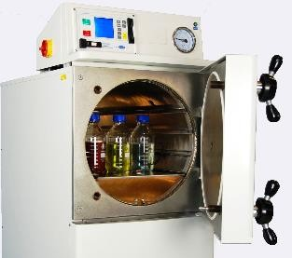
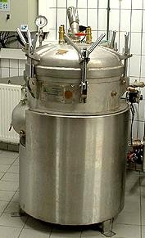
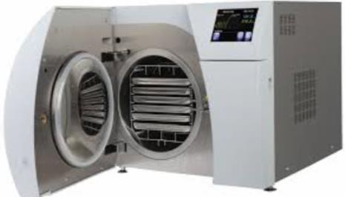
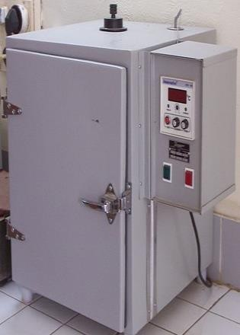
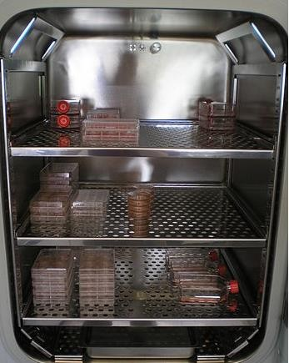
EQUIPMENTS & MATERIALS COMMONLY USED IN A LABORATORY
a)
Autoclave:
An autoclave is a device used to sterilize equipment and supplies by subjecting
them to high pressure saturated steam at 121 °C for around 15–20 minutes -or 126°C
10 minutes, or 115°C 30 minutes- depending on the size of the load and the contents
(Microbiology, Jacquelyn Black, Prentice Hall, 1993 pg 334). Typical loads include
laboratory glassware, surgical instruments and medical waste (Sterilization Cycles
Consolidated Machine Corporation Retrieved 2009-06-30). Autoclaves are widely used in
different scientific fields such as microbiology, medicine, cell biology, molecular
biology, genetics, veterinary science, and mycology, dentistry.
b)
Incubator
An incubator is a device used to grow and maintain microbiological cultures and cell
cultures. The incubator maintains optimal temperature, humidity and the carbon
dioxide (CO₂) and oxygen content of the atmosphere inside. Incubators are essential
for a lot of experimental work in cell biology, microbiology and molecular biology
and are used to culture both bacterial as well as eukaryotic cells. The optimal
temperature for frequently used bacteria in microbiology Escherichia coli (E. coli) and
mammalian cells is between 25°C -37°C while for the budding yeast Saccharomyces
cerevisiae, a growth temperature of 30 °C is optimal.
A bacteriological incubator
CO2 incubator used in cell culture
c)
Microwave Oven

Slide 2
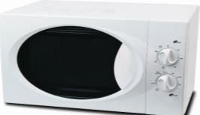
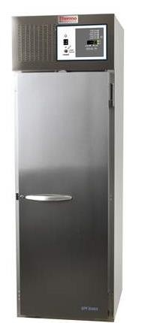
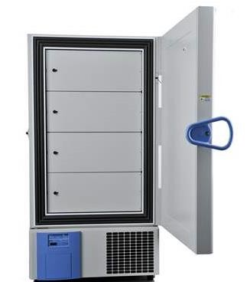
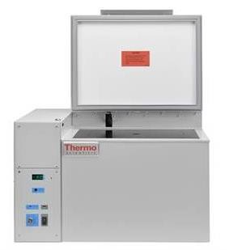
Microwave is generally used to prepare agarose gel mostly used in the area of
molecular biology and to melt medium in microbiology laboratories.
d)
Vacuum Furnace
Vacuum furnace is a machine that allows drying of heat sensitive materials using
reduced pressure at low temperatures. It is also used to water in aqueous samples by the vacuum.
e)
Freezer
Freezer is a device used to storage the samples; human blood, cell culture, DNA, RNA
samples, at -20°C, -40°C or -80°C for long periods.
-20°C Freezer
-40°C Freezer
-80°C Freezer
f)
Centrifuge
Centrifuges are commonly used in order to collect the desired part of the mixture by
precipitation as a phased. There are variable types of centrifuges as commercially available: Ultracentrifuges, Hematocrit centrifuges, Gas centrifuges, Cooled or uncooled centrifuges. The units of revolutions per minute; rpm or gravitational acceleration; g are used to calculate for a rotation speed of centrifuges.

Slide 3
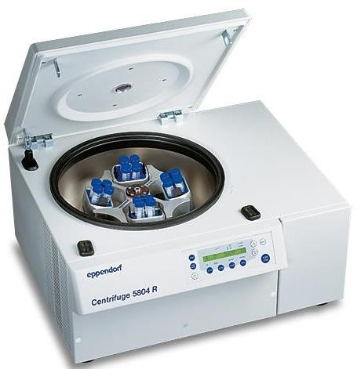
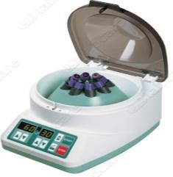
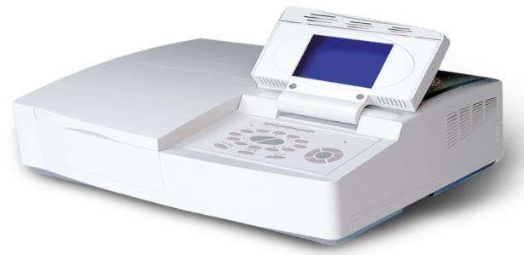
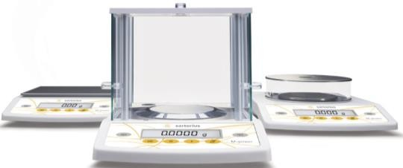
Ultracentrifuges are used to precipitate the cell organelles, such as mitochondria at
100000g and higher speed of 100000g.
g)
Spectrophotometer
Spectrophotometry is the quantitative measurement of the transmission properties of a
material as a function of wavelength. Visible light is measured in glass tub while
ultraviolet light in quartz tub. They are widely used in many industries including
semiconductors, laser and optical manufacturing, printing and forensic examination,
and as well in laboratories for the study of chemical substances. Ultimately, a
spectrophotometer is able to determine, depending on the control or calibration, what
substances are present in a target and exactly how much through calculations of
observed wavelength.
h)
Analytical Balance
It is an instrument capable of making precise measurements of weight of objects of
relatively small mass: of the order of a thousand parts of a gram; milligram,mg. As
with other laboratory machines and equipment, balancers must be set up and
controlled in certain intervals.

Slide 4
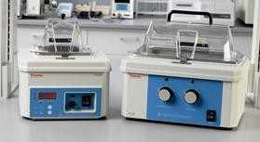
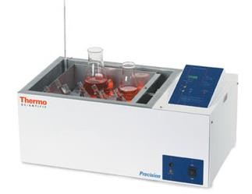
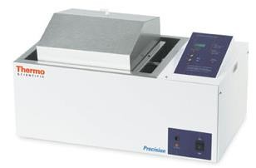
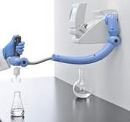
i)
Water Bath
There are two types of water baths, digital and analog, both of them can be heated up
to 100 degree centigrade.
j)
Shaker Bath
Shaker bath is used to mix various solutions and the speed and temperature of machine
can be adjusted.
k)
Distilled Water Device
This machine is used, to produce pure water, for the removal of impurities from tap
water.
l)
Electrophoresis Device
Polyacrylamide and agarose gel electrophoresis are applied for the separation and
characterization of proteins, nucleic acids (deoxyribonucleic acid; DNA and
ribonucleic acid; RNA). The principle of this method is that the charged particles of a
sample such as DNA migrate in an applied electrical field. For instance, DNA is a
negatively charged molecules and gel electrophoresis is positively charged therefore,
DNA fragments easily migrate to the positive side of the acrylamide gel.

Slide 5
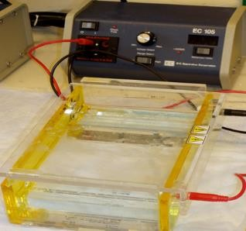
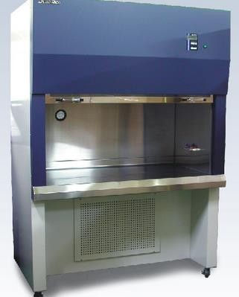
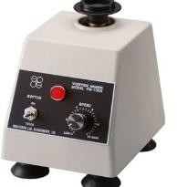
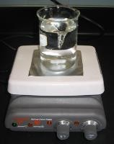
m)
Laminar Flow
The device allows working with drug, culture, chemical and microorganisms in
a sterile environment. A laminar flow cabinet or bio safety cabinet or tissue culture
hood is a carefully enclosed bench designed to prevent contamination of
semiconductor wafers, biological samples, or any particle sensitive device. Air is
drawn through a HEPA filter and blown in a very smooth, laminar flow towards the
user. The cabinet is usually made of stainless steel with no gaps or joints where spores
might collect.
n)
Vortex
Vortex is commonly used to provide a homogeneous mixing of the test tube contents.
o)
Magnetic Stirrer or Mixer and Magnetic Heater
A magnetic stirrer or magnetic mixer employs a rotating magnetic field to cause a stir
bar immersed in a liquid to spin very quickly, thus stirring it. The rotating field may be
created either by a rotating magnet or a set of stationary electromagnets, placed
beneath the vessel with the liquid. The temperature of mixer can be adjusted.
Vortex
Magnetic Stirrer

Slide 6
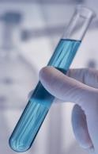
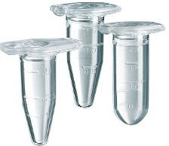
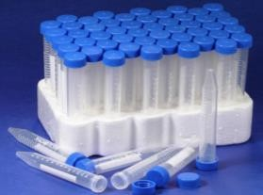
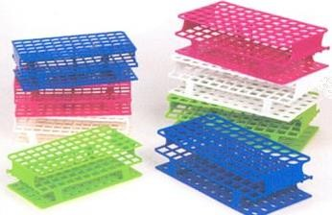
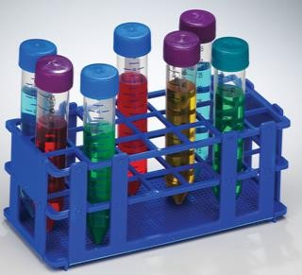
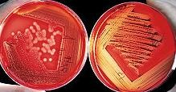
p)
Tubes
There are four types of tubes used in the different scientific fields; microbiology,
molecular biology, genetics and immunology.
Test tubes; is a common piece of laboratory glassware consisting of clear plastic
tubing, open at the top, with a rounded U-shaped bottom.
Eppendorf tubes; are 1.5 mL or 2mL micro test tubes connected with a plastic cover
on top used in mostly biotechnology laboratories.
Durham tubes; are used to detect whether there is a production of gas by
microorganisms.
Centrifuge tubes; are made of glass or plastic used extensively in molecular biology
laboratories. The most commonly encountered tubes are of about the size and shape of
a normal test tube. Also, the bottom portion of tubes is narrow and specific for only
centrifuges machines.
q)
Test Tube Holder
Tube holders are made of plastic, wooden or metal materials in which are different
diameters holes and used to put the tubes appropriately.
r)
Petri Dish (Agar Plate)
Petri Dishes are shallow lidded dish and the main laboratory equipment mostly used in
microbiology. Glass petri dishes can be reused by sterilization whilst plastic petri dishes often used as disposables in order to eliminate contamination.
http://en.wikipedia.org/wiki/Agar_plate

Slide 7
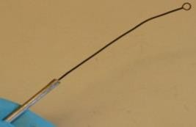
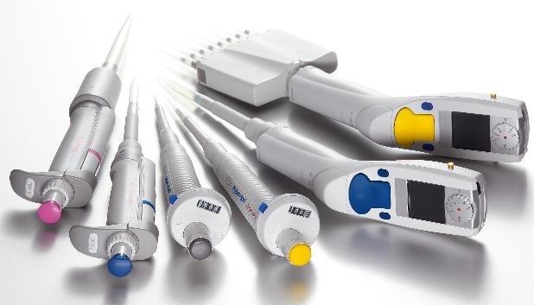
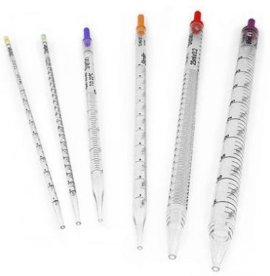
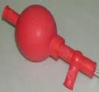
s)
Inoculation Loop
An inoculation loop is used to transfer bacteria for microbiological culture.
t)
Pipettes
http://en.wikipedia.org/wiki/Inoculation_loop
There are two different types of Micropipettes; single-channel and multichannel,
which are the most used laboratory equipment and both of the types are operated by
piston-air displacement. These pipettes are required disposable tips that come in
contact with the fluid. There are four standardized single-channel pipettes,
commercially available, measured volume between 0.1 µl to 1000 µl (1ml) (see Table
1).
Table 1: Four different Single- channel pipettes
Pipette type
Volumes (μL)
P10
0.5 – 10
P20
2 – 20
P200
20 – 200
P1000
200 – 1000
A manual propipetter, is adjusted by squeezing the bulb and used to pull toxic and
dangerous liquids by bulb.
Drain-out pipettes help to pull the needed volume into the pipette and can be
aliquoted out if the pulled volume is more than needed.
!!! Please do not drop pipettes on the ground !!!

Slide 8
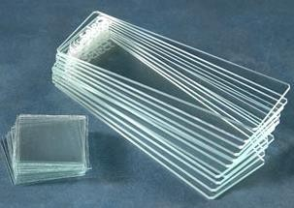
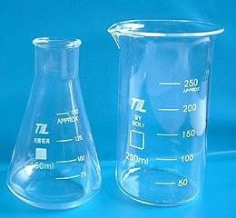
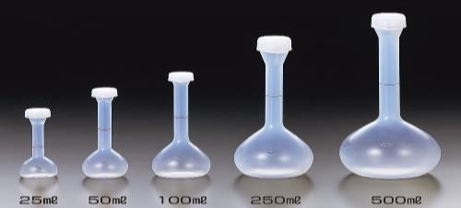
u)
Glass slide and cover slips
Glass slides and cover slips are used to hold biological samples, in natural forms or
after staining, for examination under the microscope. Cover slip is smaller and thinner
than glass slide and always used together which allows the samples easily inserted and
removed from the microscope transported and stored in slide cases.
v)
–Erlenmeyer: Erlenmeyer flasks are heat-resistant and extremely useful in the lab
setting for stirring the contents by hand by swirling the flask because of its flat bottom, conical body and cylindrical neck.
-Beaker is a container for stirring, mixing and heating liquids; is generally cylindrical
in shape, with a flat bottom.
-Volumetric flasks are made of plastic or glass materials, ranging from 10ml to
1000ml that are used for precise dilutions and preparation of standard solutions in mostly chemistry laboratories.
-Round bottom flasks, are usually used to dilute solutions and liquids mostly in
chemistry and molecular biology laboratories.
-Mortar, is a bowl, made of wood or ceramic. The substance is placed on the ground
of mortar and crushed or mixed with the pestle; mostly used in pharmacies.
-Dry ice is the solid form of carbon dioxide. It is not very toxic and much cooler than
water ice thus usually uses as a cooling agent in the laboratory.

